Slide 1
A Service Oriented Architecture for the Digitalization and Automation of Distribution Grids
Amirfazel koozegar
Reza FarahBakhsh
Mohammadhossein saedi
Alireza zare zeinabadi 😵

Slide 2
Topics covered
Problem
Requirement
SOSE
SOSE Principles
SOA
Digitalization and Automation of Distribution Grids
Conclusion
References

Slide 3
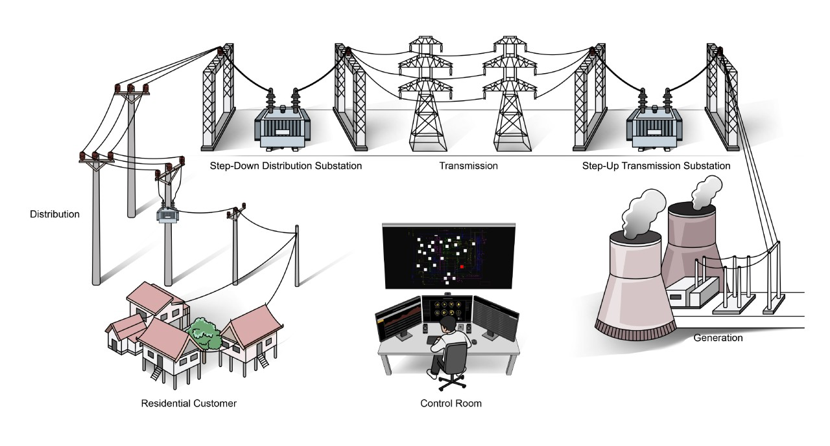
The Problem
Distribution grids are at the center of the ongoing transition in the energy sector.
a further increase of the Distributed Generation (DG) based on renewable sources, is largely connected to the distribution level of the electrical grid.
New stakeholders, such as energy aggregators, local energy communities,.. Are entering the business value chain.
New level of complexity is emerged.
New approaches for operating and managing Grids is needed.

Slide 4
Distribution Management System (DMS) Requirements
Real-time communication
Interoperability
Scalability
Reliability and Security
Cost-Effective Optimized Solutions

Slide 5
SOSE The inspiration
Service-oriented development views a system as an aggregation of services.
It defines a way to make software components reusable using the interfaces.
Formally, SOSE is an architectural approach in which applications make use of
In this architecture, services are provided to form applications, through a network call over the internet services available in the network.
Each service in SOSE is a complete business function in itself.

Slide 6
SOSE Benefits
Services can be offered by any service provider inside or outside of an organization
The service provider makes information about the service public so that any authorized user can use the service.
Applications can delay the binding of services until they are deployed or until execution.
Applications can be made smaller, which is particularly important for mobile devices with limited processing and memory capabilities. Computationally-intensive processing can be offloaded to external services.

Slide 7
Principles of SOSE
Provides interoperability between the services.
better scalability and availability.
Ease of maintenance with reduced cost of application development and deployment.

Slide 8
SOSE is Not Micro-Service!!

Slide 9
SOA The solution
Service-oriented architecture (SOA) is a means of developing distributed systems where the components are stand-alone services.
Services may execute on different computers from different service providers. Standard protocols have been developed to support service communication and information exchange.

Slide 10
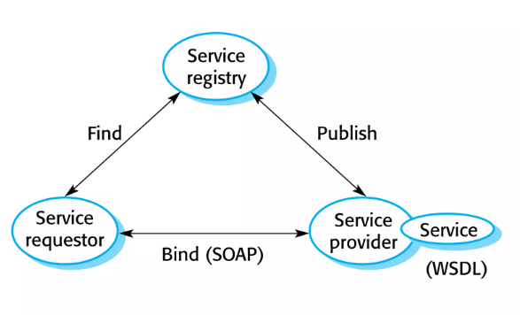
Service Oriented Architecture
Service-oriented architecture (SOA) is a means of developing distributed systems where the components are stand-alone services.
Services may execute on different computers from different service providers. Standard protocols have been developed to support service communication and information exchange.

Slide 11
Service Oriented Architecture

Slide 12
Service Oriented Architecture
SOAP
A message exchange standard that supports service communication

Slide 13
Service Oriented Architecture
WSDL (Web Service Definition Language)
This standard allows a service interface and its bindings to be defined.

Slide 14
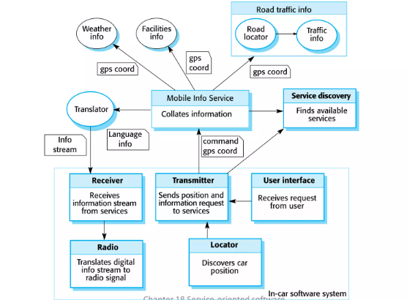
Service Oriented Architecture in real life

Slide 16
The solution
digitalizing and automating distribution grids.
New Architecture focusing on modular design using microservices and container technology.
This architecture aims to address the challenges in modern distribution grids.

Slide 17
Benefits
enhances flexibility, scalability, and efficiency.
emphasizes real-time communication, interoperability, and improved data management.
make the grid more adaptable, secure, and capable of integrating renewable energy sources efficiently.
improving overall grid reliability and performance.

Slide 18
DMS Platform

Slide 19
DMS Platform
Is a micro-service & containerized platform

Slide 20
DMS Platform
Benefits of Micro-services
clear definition of the interfaces between different services.
fully independent development of each microservice
easier understanding and maintenance
easier computational load balancing

Slide 21
DMS Platform
Benefits of CONTAINERIZATION
easy replication and light deployment
scalable deployment of large number of microservices
optimization of the hardware usage
no requirements for the underlying operating system

Slide 22
Conclusion
Introduced a service oriented architecture based on last generation IoT technologies to address the requirements of digitalization and smart management of DSOs.
Used both micro-services and containerization approach to create a new solution
unlocking new opportunities for a more open, flexible, dynamic and competitive market of turnkey services, instead of having monolithic architectures.

Slide 23
Refrences
M. Pau, M. Mirz, J. Dinkelbach, P. Mckeever, F. Ponci and A. Monti, "A Service Oriented Architecture for the Digitalization and Automation of Distribution Grids," in IEEE Access, vol. 10, pp. 37050-37063, 2022, doi: 10.1109/ACCESS.2022.3164393.

Slide 24
The End

